Slide 1
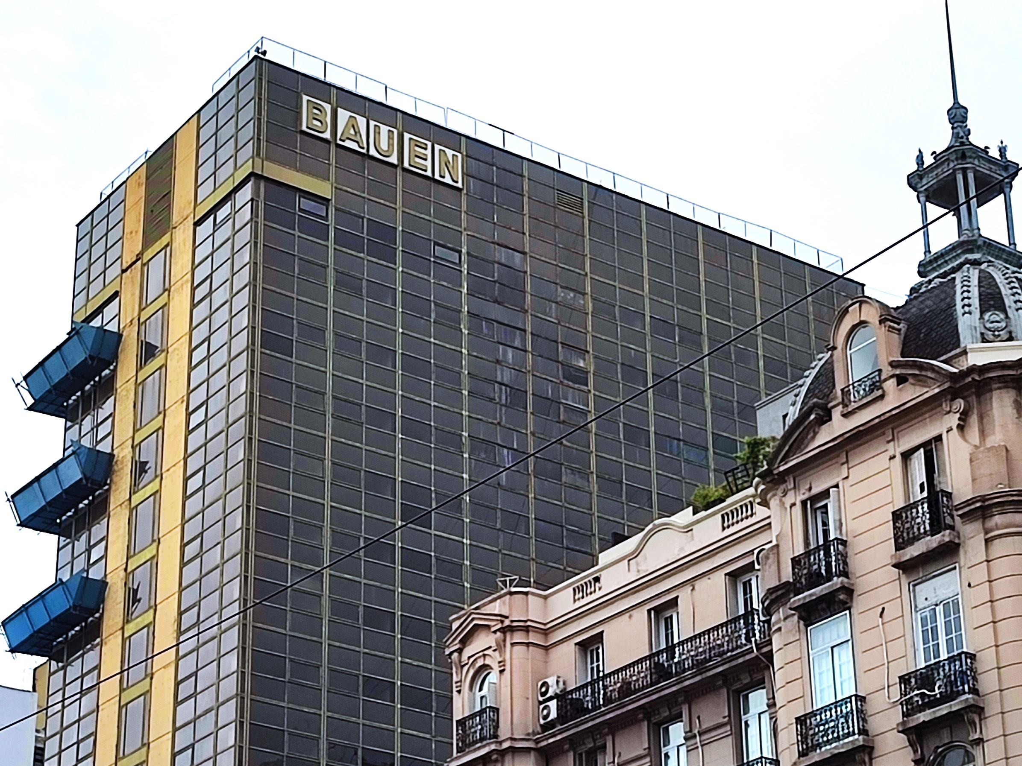
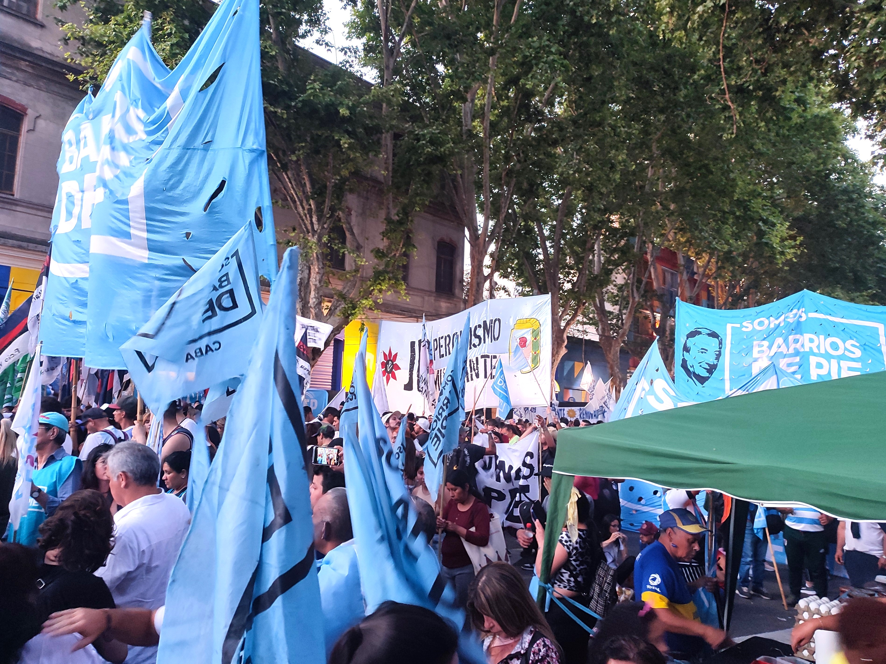
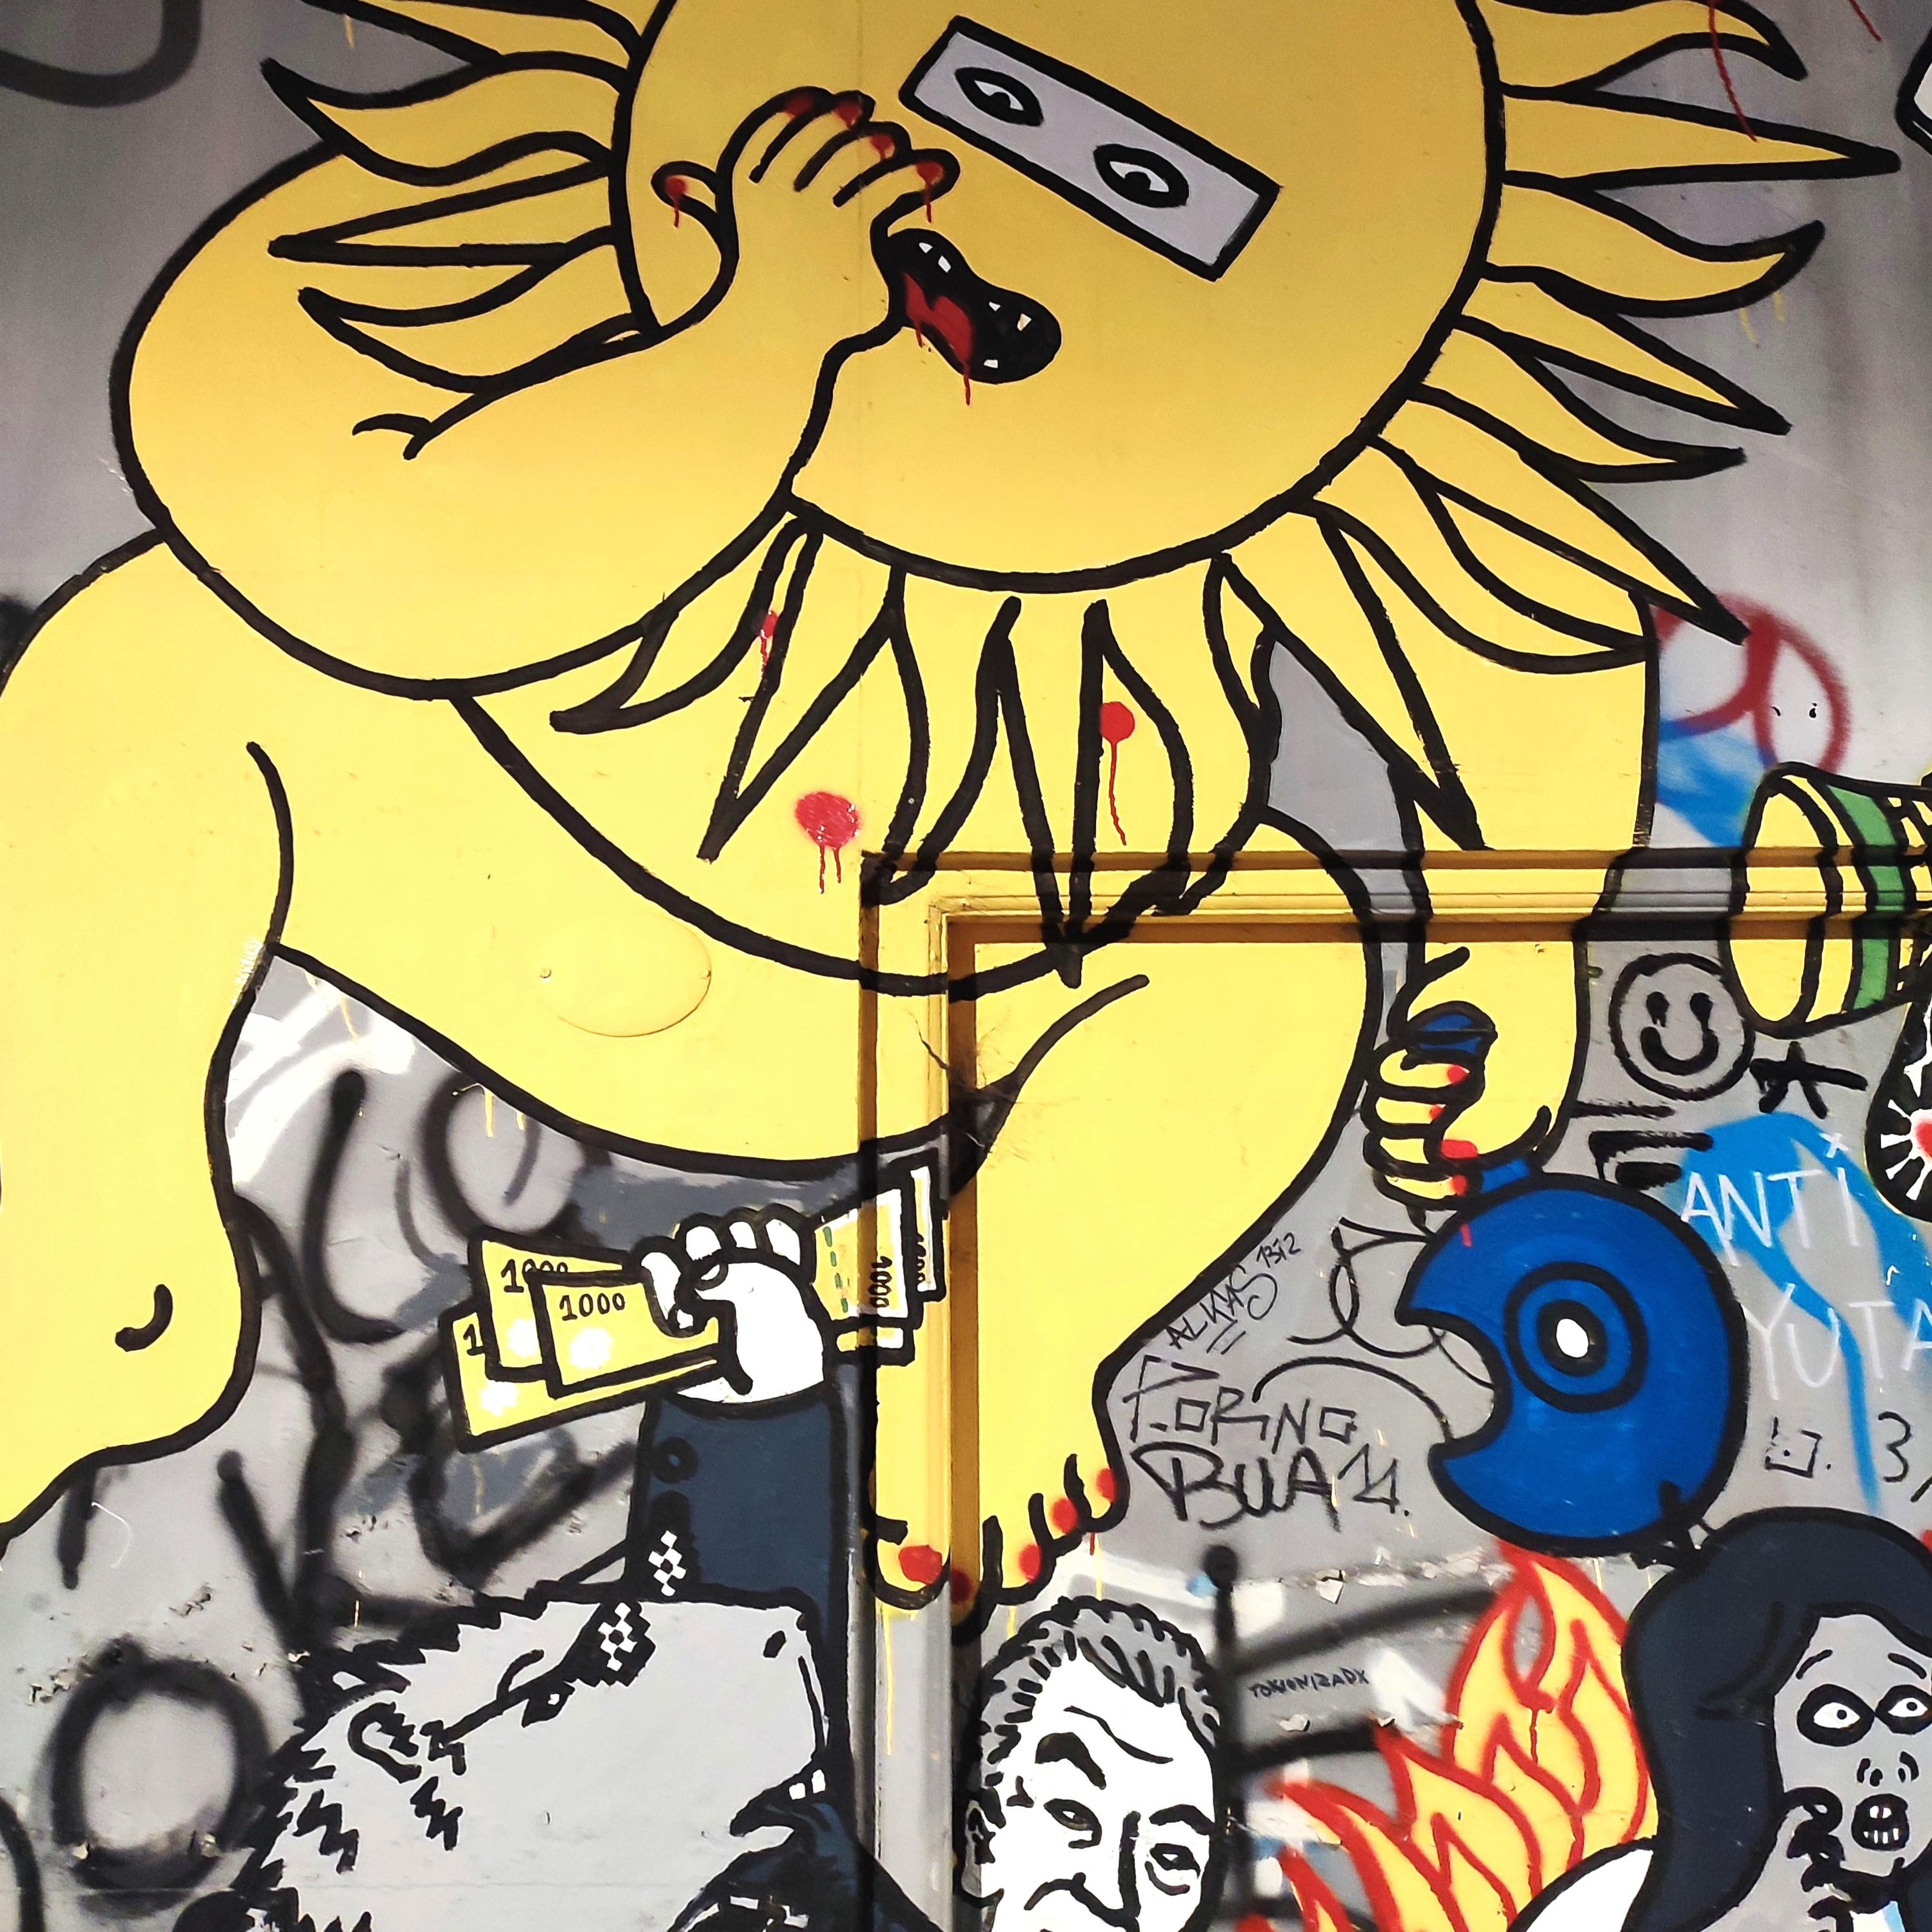
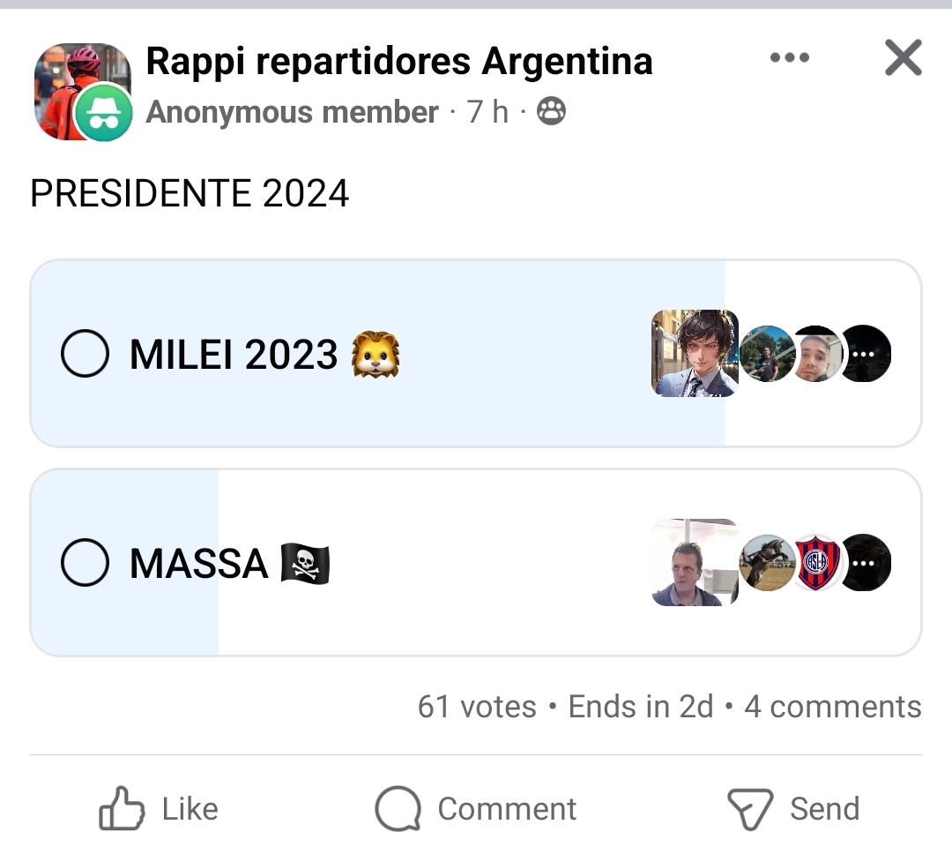
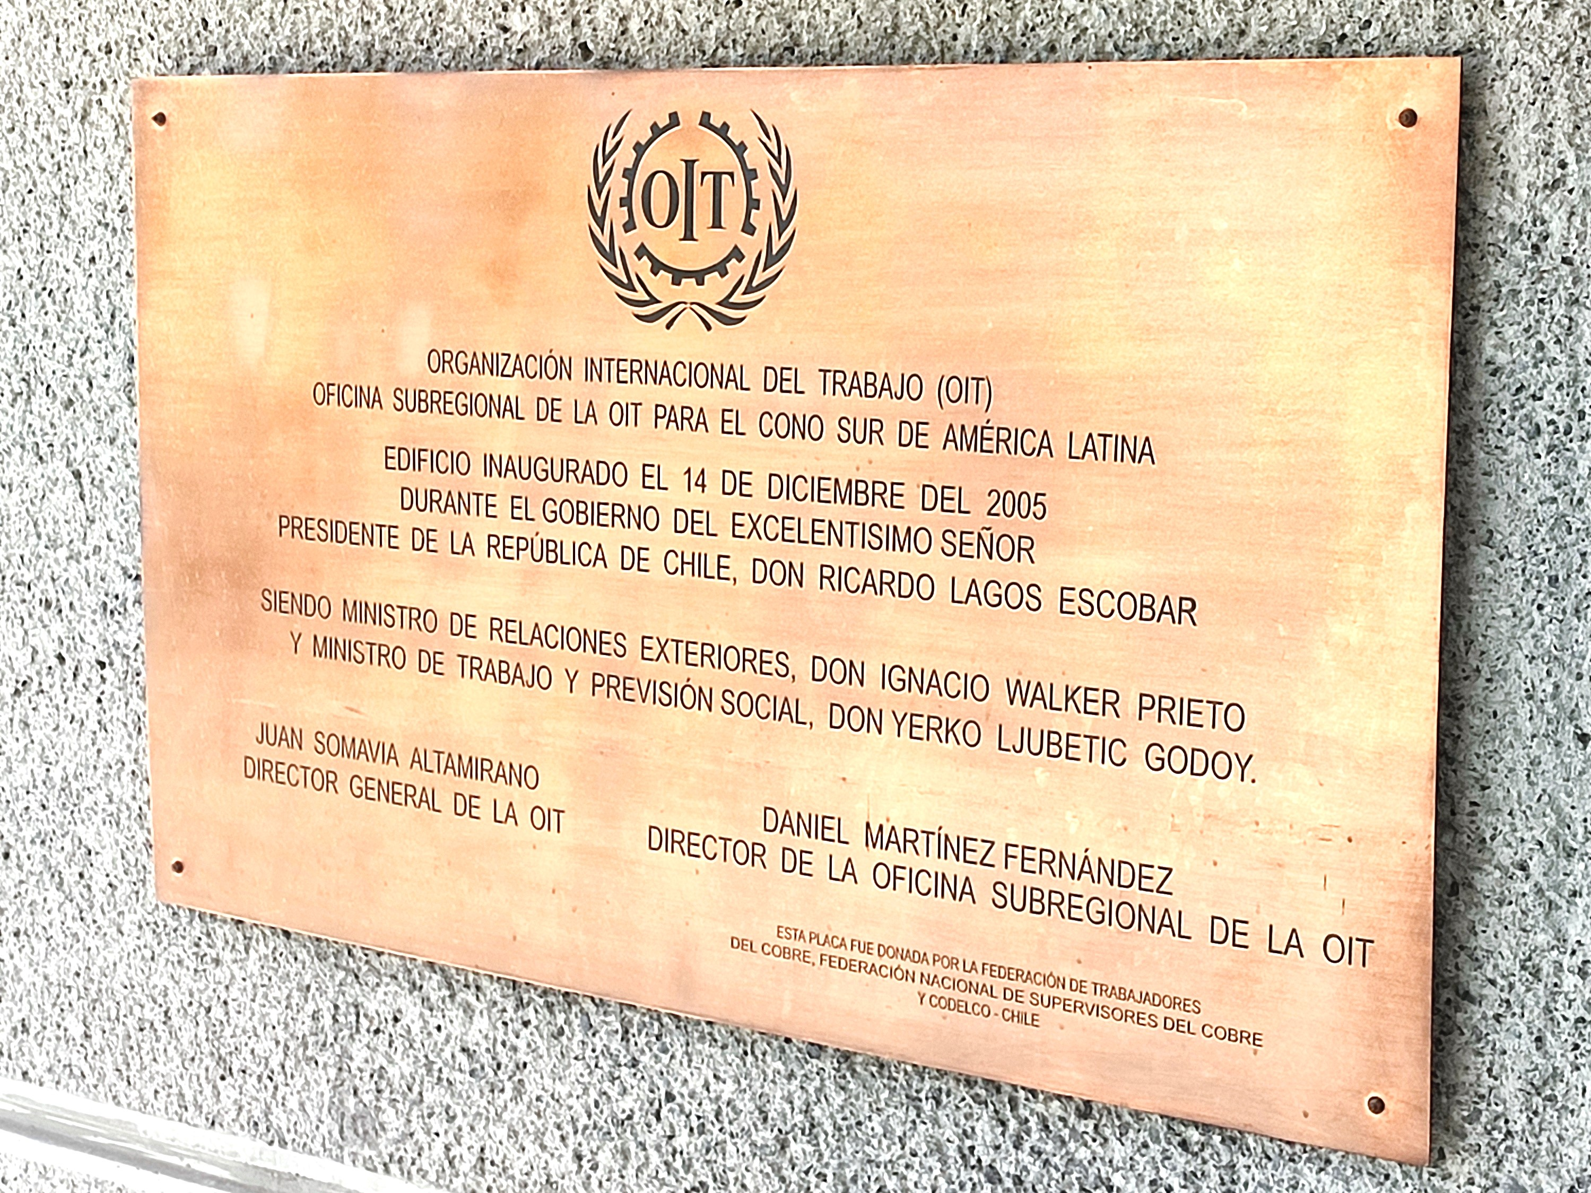
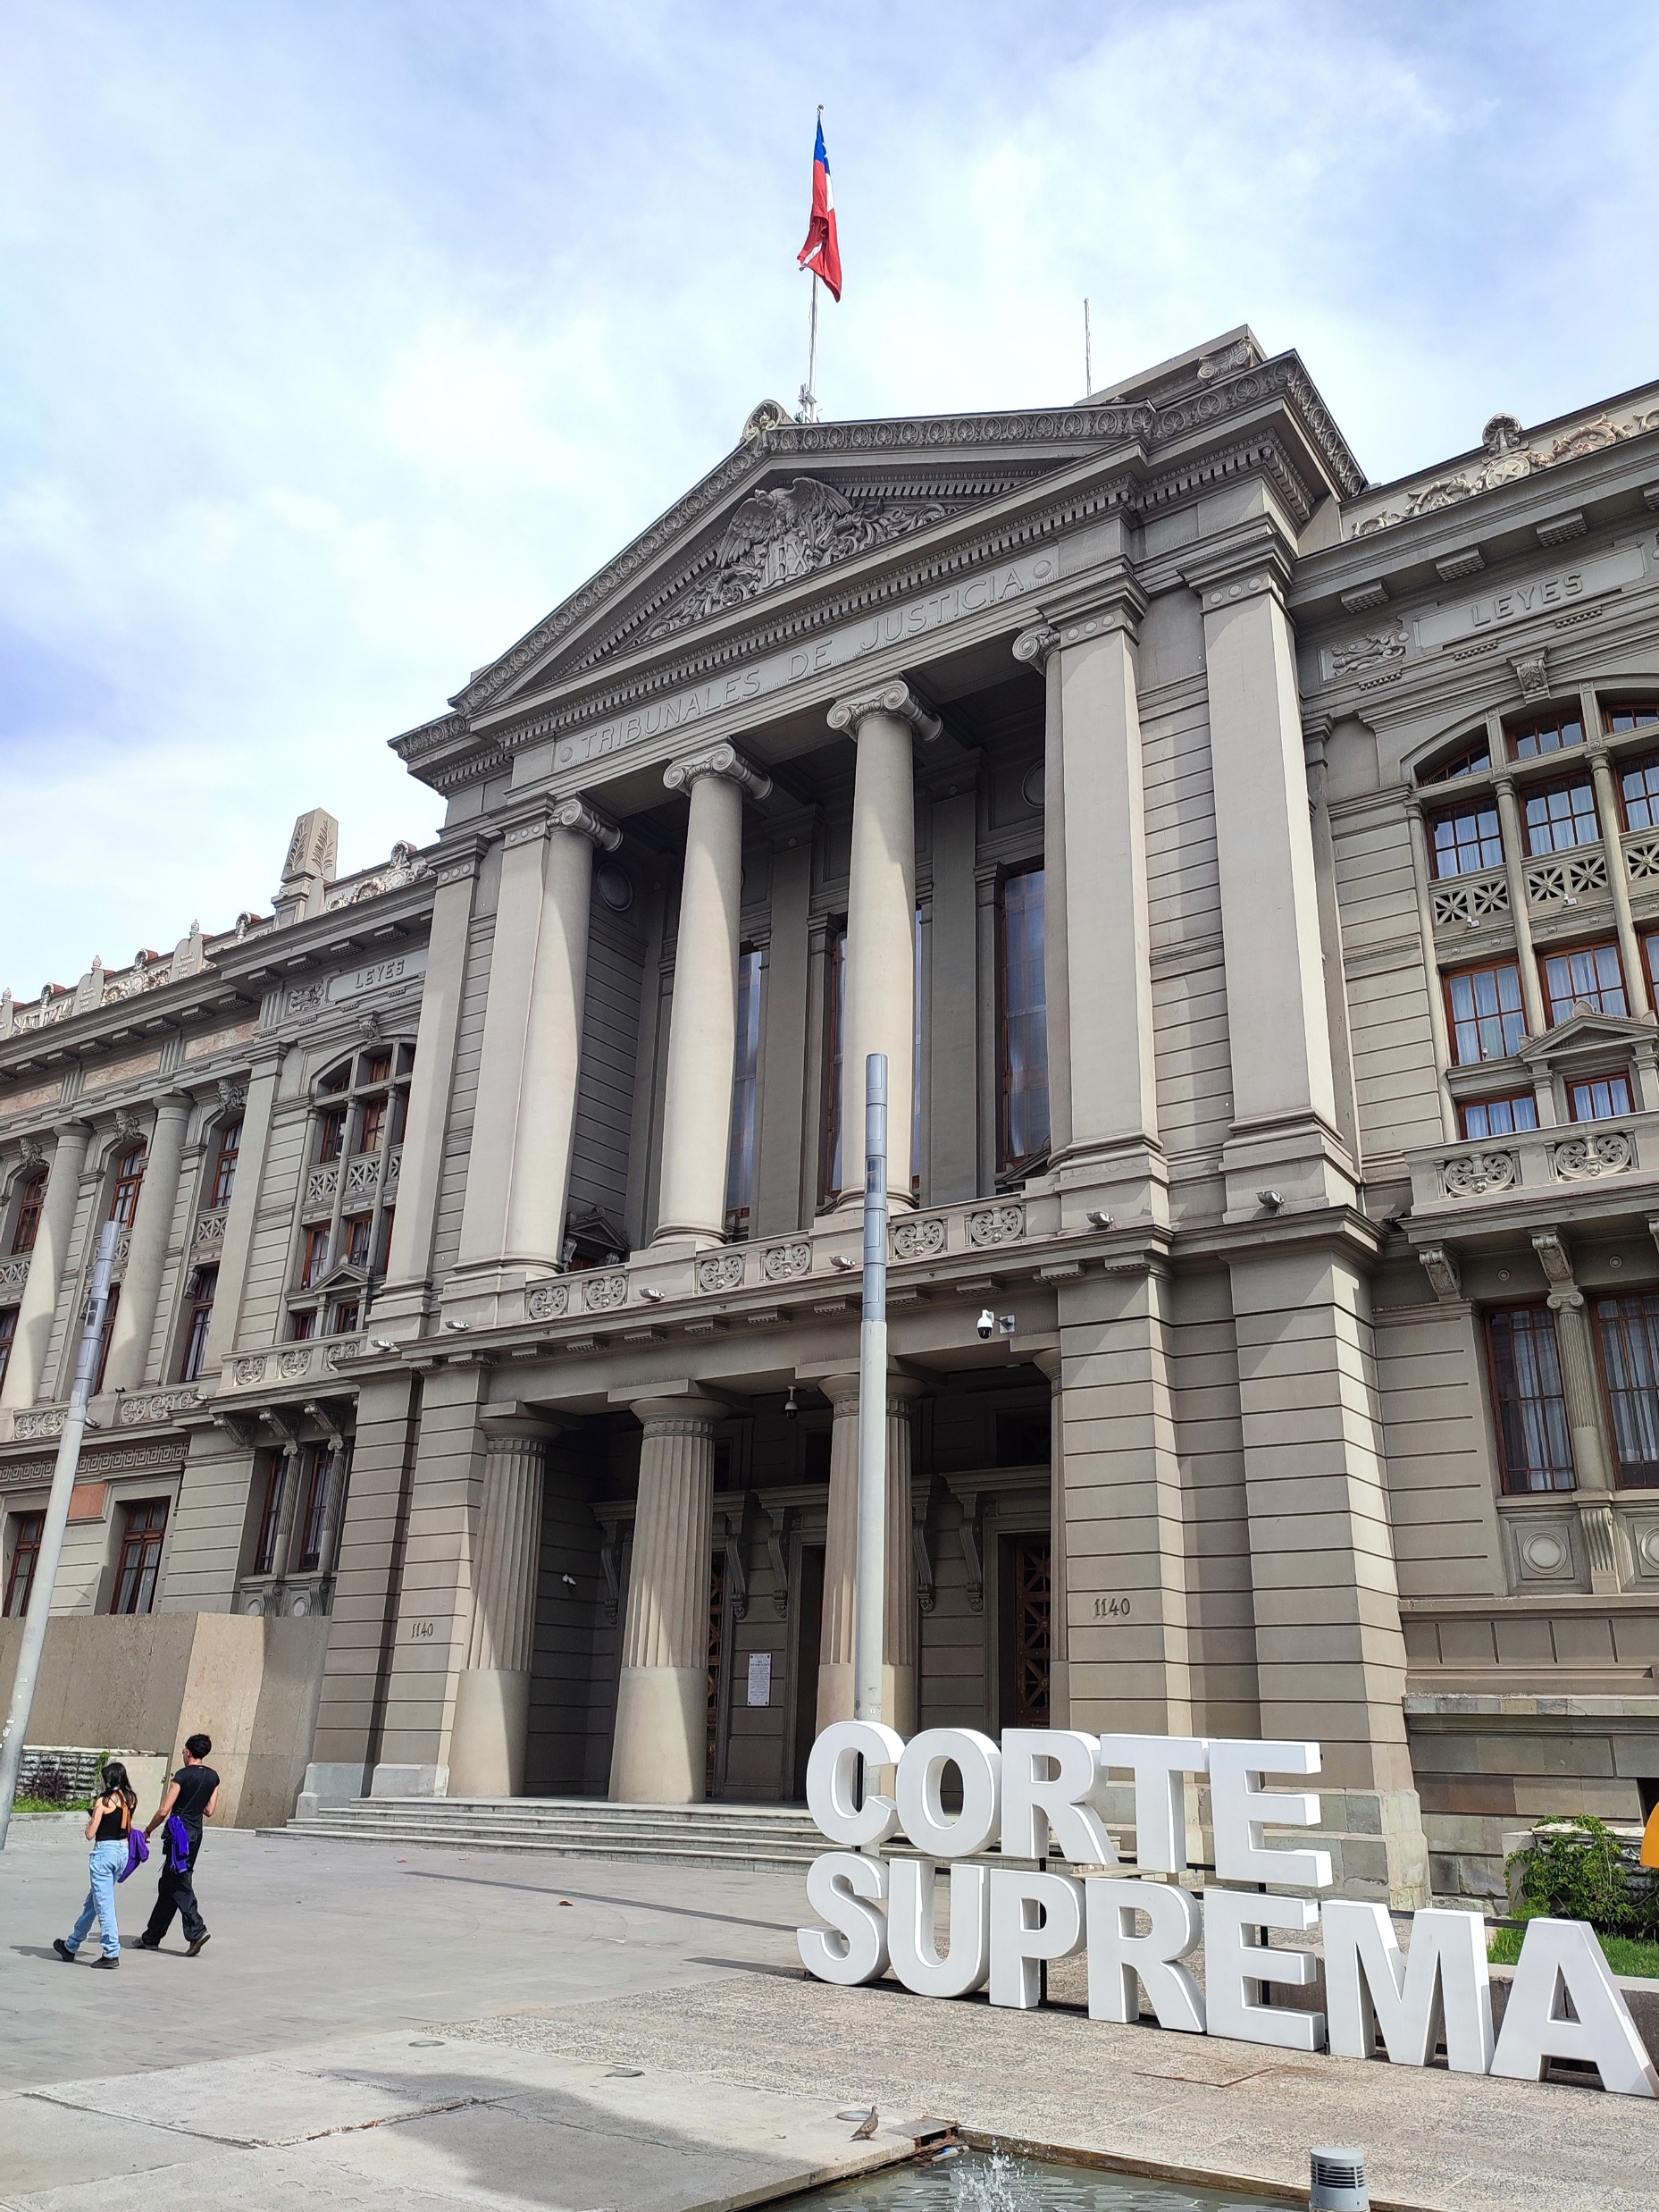
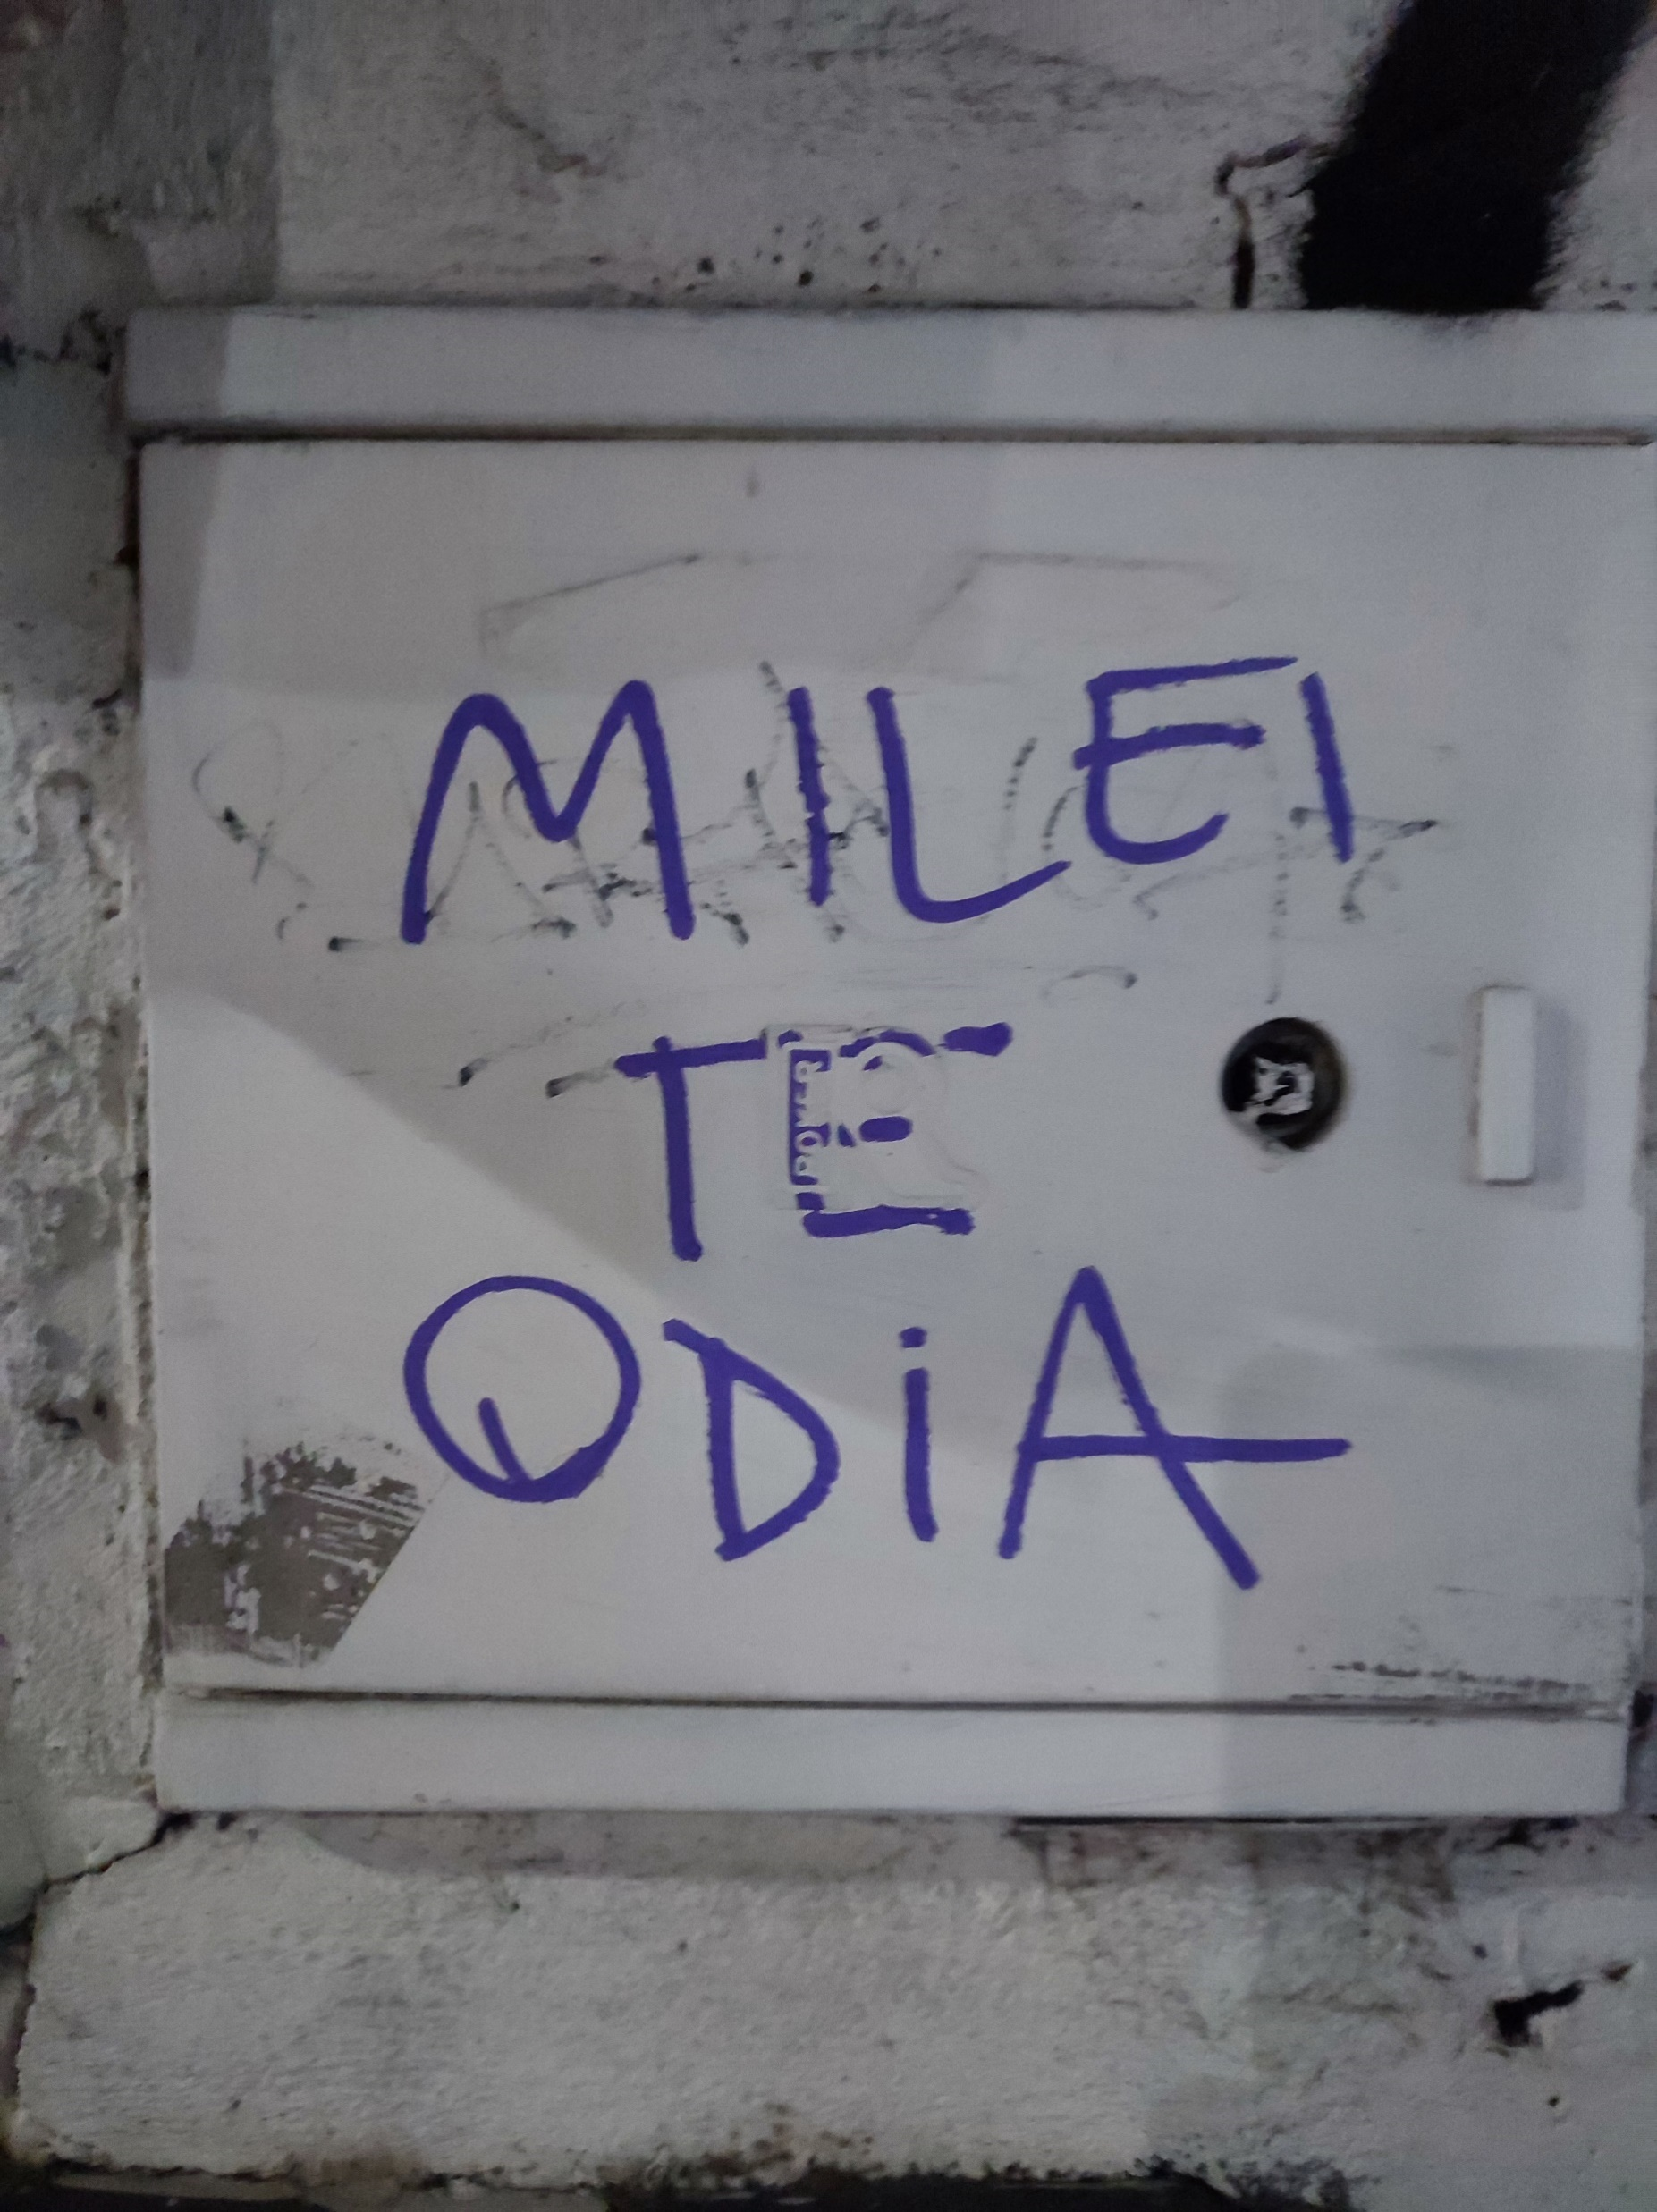
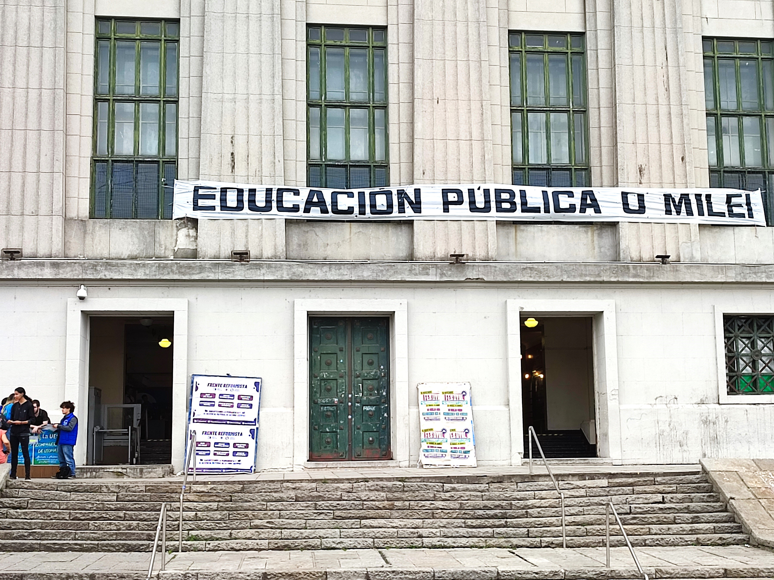
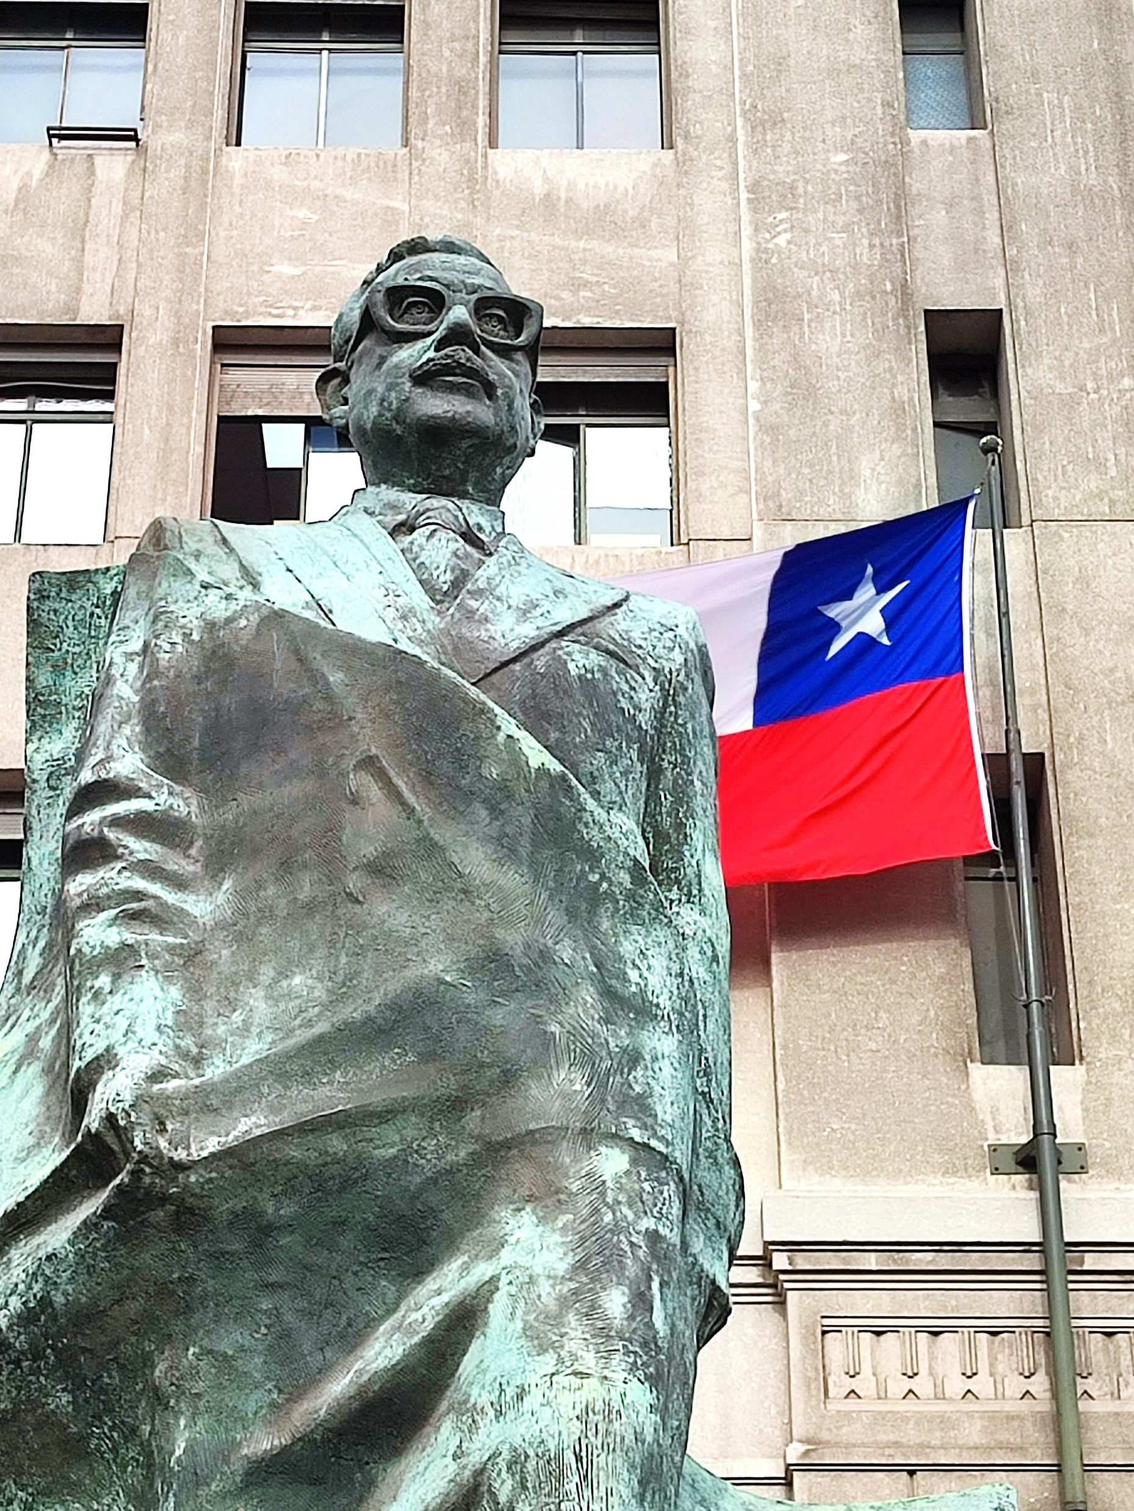
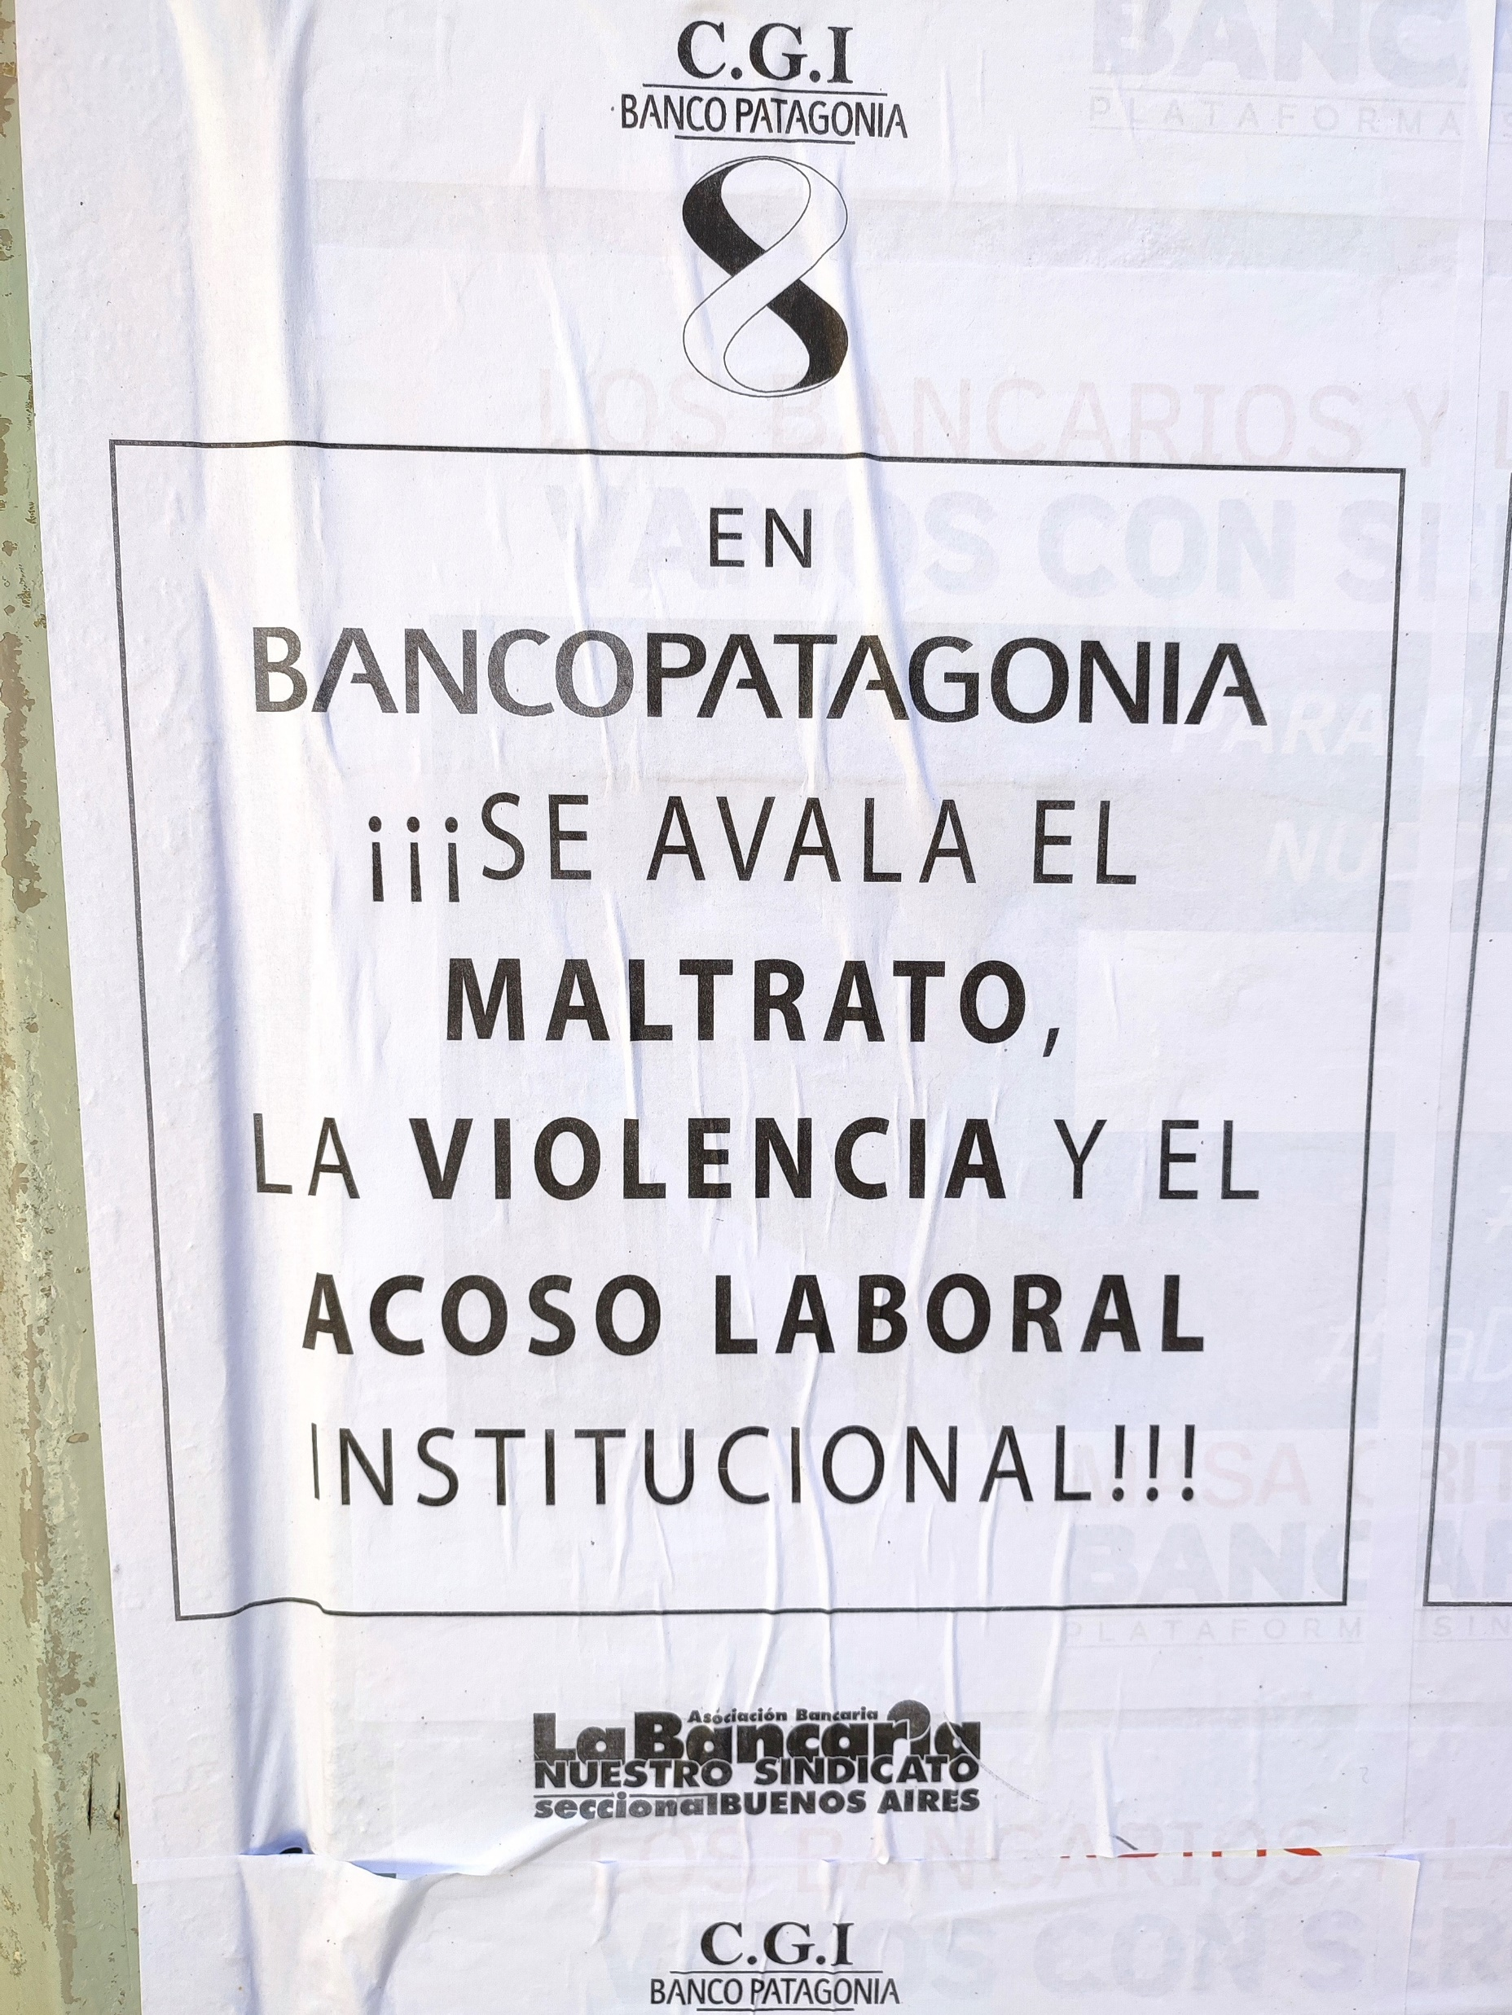
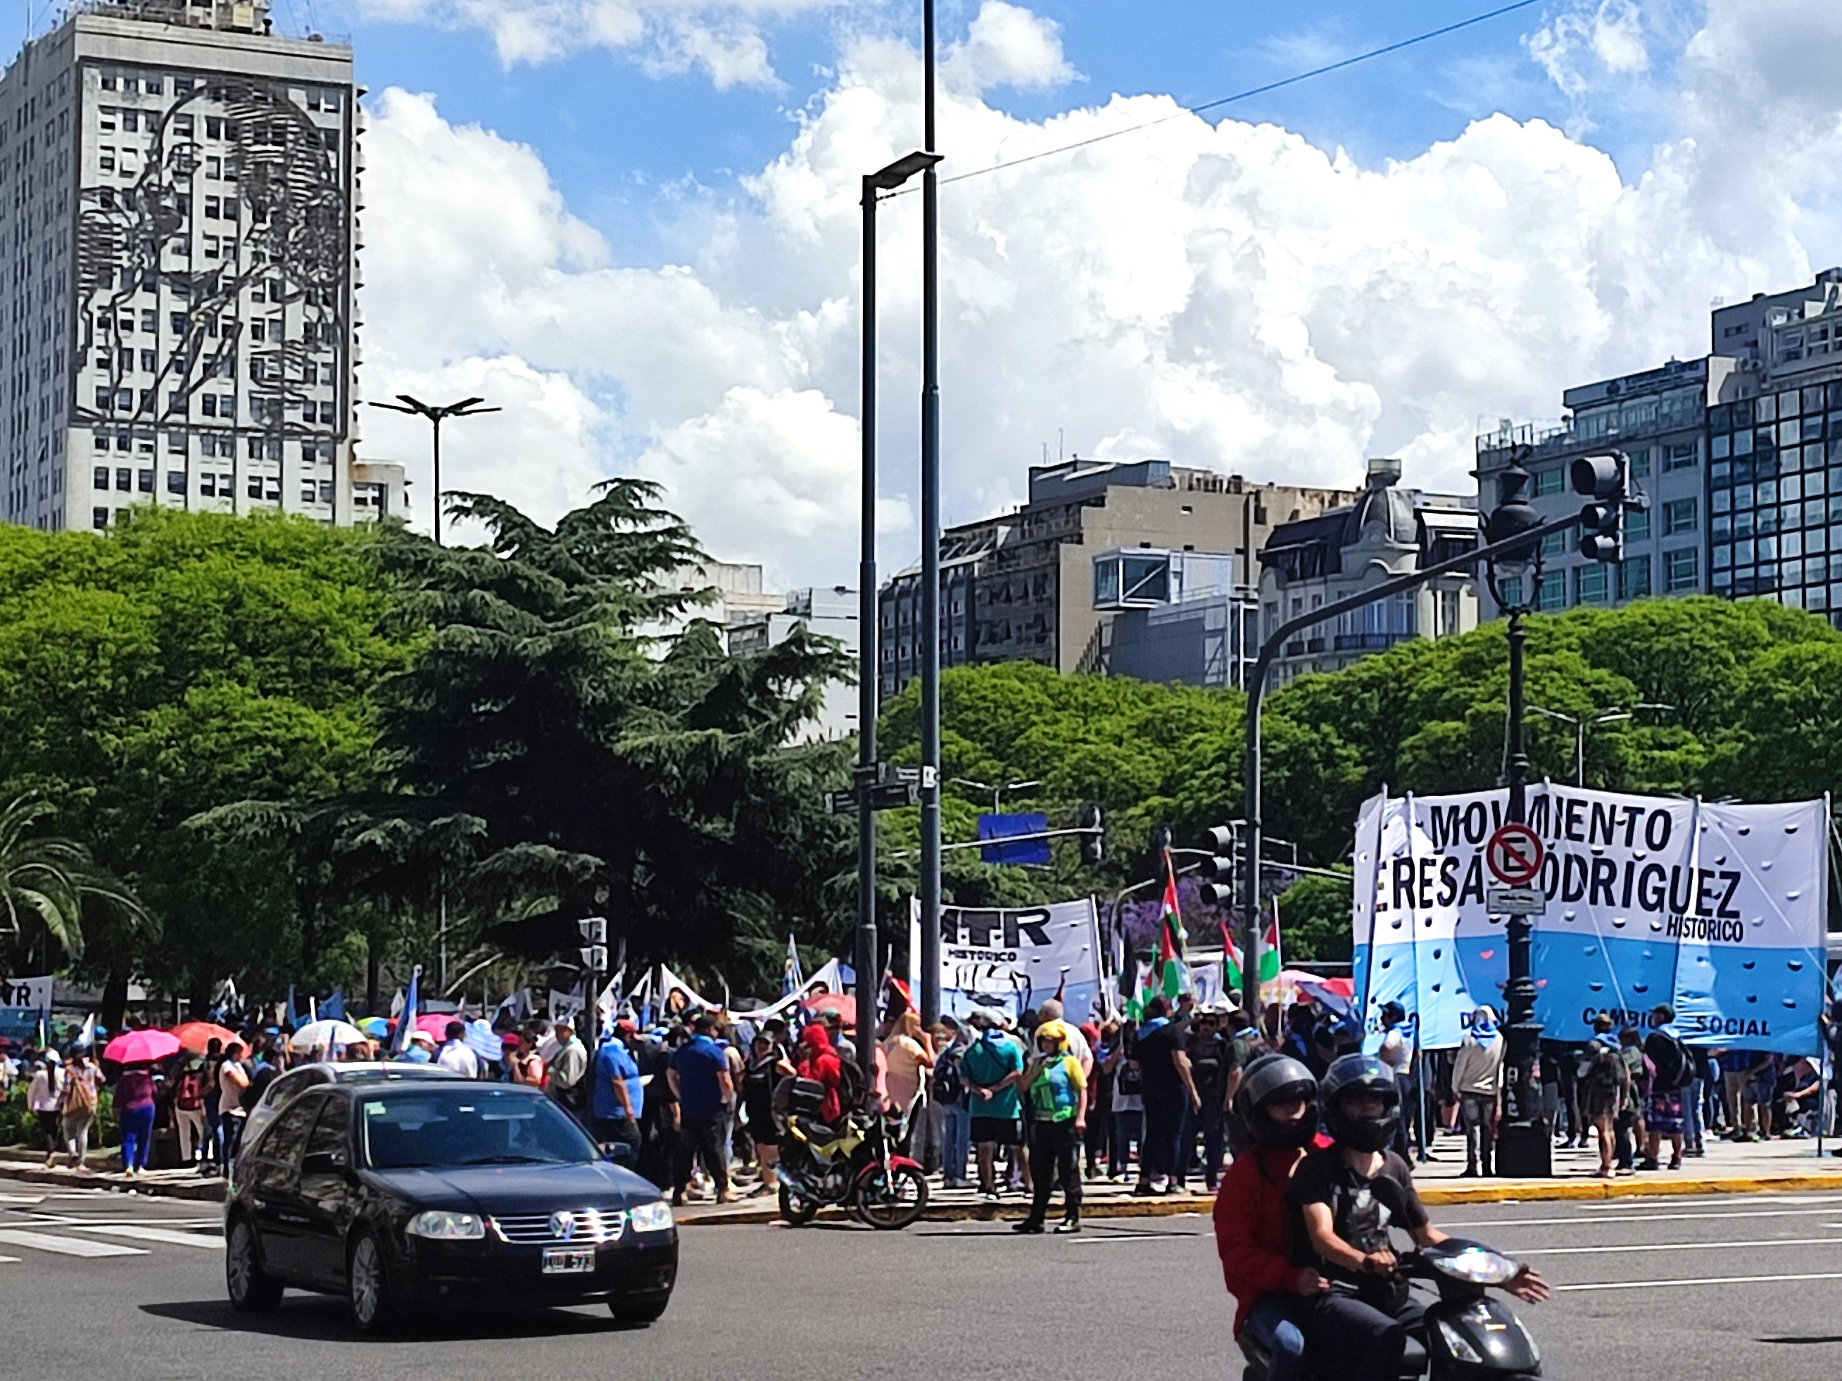
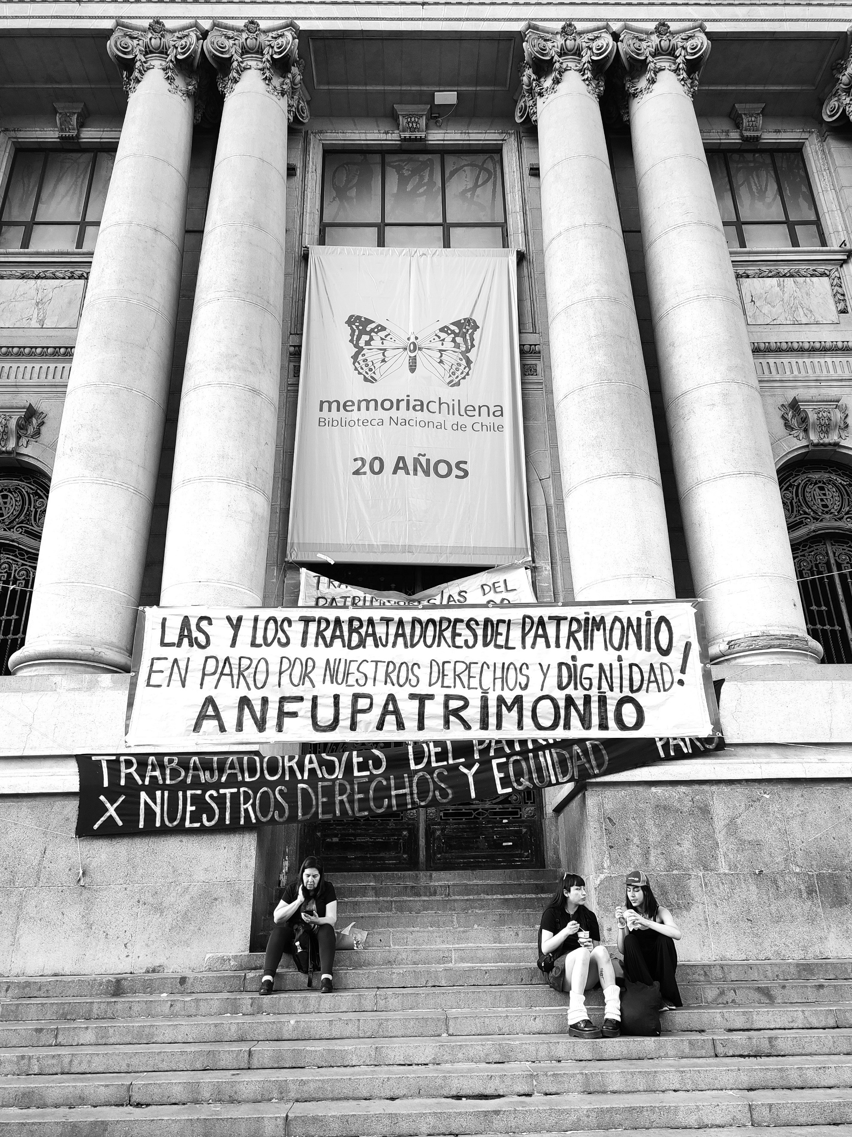
Labour relations in Latin America Current challenges and future directions
30th April 2024, AMBS

Slide 2
Labour Relations in Latin America
Current challenges and future directions
30th April 2024
Work and Equialities Institute
Notes:
We are surrounded by manifestations of the digitisation of the world of work and the creation of new digital labour markets,
We are also reminded (more than once a day!) that technology will change our lives and our work, with still little challenge to the most obvious forms of technological determinism.
As part of this we have witnessed the advancement of platform work, algorithmic management and the growth and development of artificial intelligence systems at work.
Employment Relations and labour law as fields of studies, are requiered to eximine the (differential) adoption of these technologies and assess their impacts on occupations workplaces and ER systems including regulatory disruptions, responses and developments.

Slide 3
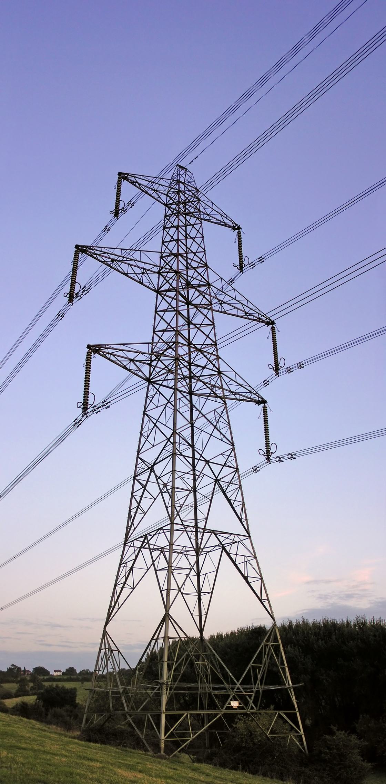
Motives
Nature and Scope
Battles
Regional variation
Effects
Necessity arguments
A new design of the
overhead power lines
of work and employment
in Latin America?
Notes:
We are surrounded by manifestations of the digitisation of the world of work and the creation of new digital labour markets,
We are also reminded (more than once a day!) that technology will change our lives and our work, with still little challenge to the most obvious forms of technological determinism.
As part of this we have witnessed the advancement of platform work, algorithmic management and the growth and development of artificial intelligence systems at work.
Employment Relations and labour law as fields of studies, are requiered to eximine the (differential) adoption of these technologies and assess their impacts on occupations workplaces and ER systems including regulatory disruptions, responses and developments.

Slide 4
90s Labour reforms | Key elements | Argentina | Brazil | Bolivia | Colombia | Chile | Ecuador | México | Perú | Uruguay | Venezuela
Contractual Arrangements and Conditions | Contracts | · | · |  | · |  | · |  | ·
 | Trial period | · |  |  |  |  |  |  | · |  | ·
 | Dismissal causes |  |  |  |  | · |  |  | ·
 | Severance pay changes | · | · |  | · |  | · |  | ·
 | Flexibility in working hours | · | · |  | · |  |  |  | ·
Labour Market Regulations and Policies | Changes in minimum wage |  |  |  | · |  |  |  | · |  | ·
 | Exemptions from labour law for SMEs. | · | · |  | ·
Collective rights and representation | Decentralization in collective bargaining | · |  |  |  |  |  |  | ·
 | New forms of extrajudicial conflict resolution | · |  |  |  | · |  |  | · |  | ·
Main instruments |  | 1994 Reforma Constitucional, Leyes y Decretos nacionales | 1993 Modificaciones a la Ley Consolidación de Leyes de Trabajo | 1994 Constitución Política y sus reformas | 1990/1 Constitución Política de Colombia, Ley Nº 50/Ley N° 584 | ! Relevance of the Plan Laboralm 1994 Modificaciones al Código del Trabajo (19010, 19069, 19049) | 1991 Codificación del Código de Trabajo, 2000 Código del Trabajo 144 | ! After in connection with trade Agreements | 1993-1997 Constitución Política, Leyes y Decretos | 1989 Constitución de la República Oriental del Uruguay | 1990-1997 Ley Orgánica del Trabajo
LZ based on Vega Ruiz, 2005 and Senén González and Aravena Carrasco, 2023

Slide 5
 | Argentina | Brazil | Colombia | Chile | México
Contractual arrangements and Conditions | 2023 Decree and under debate | under debate | under debate (-) | 2022 y 2023 | 2019 + under debate
Labour Market Regulations and Policies | 2023 Decree and under debate | ? | under debate (-) | 2022 y 2023 | 2019 + under debate
Collective Rights and Representation | 2023 Decree and under debate | under debate | under debate (-) | 2022 y 2023 | 2019 + under debate
Are these “reintroducing” lost protections or developing strategies to tackle new challenges?
Are these effectively addressing historical injustices?

Slide 6
The social protection
system in Argentina.
What to expect from the libertarian experiment?
Tomás Nougués (UNSAM/CONICET)

Slide 7
The Libertarian goverment program
1
The Chainsaw
Layoffs
Discontinuation and discharges Cutbacks
2
The Blender
Budget freeze Devaluation Curtailed expenses

Slide 8
The dismantling of the social protection system is a direct blow to the labor movement.
Cutbacks
+20k public sector workers
Pension reform
Liquification
Wages
Loss of purchasing power
More massive layoffs
Privatization
Formal workers below poverty line

Slide 9
Labour Relations in Latin America – Current challenges and future directions 30th April 2024
New employment regulations in Chile: business as usual?
Angel Martin-Caballero
PhD researcher WEI and RA DWC
Alliance Manchester Business School

Slide 10
Chilean ER system at crossroads
Well-known example of an “advanced neoliberal country” (Ruiz & Boccardo, 2014)
“Labour Plan” - Decentralised collective bargaining system, restricted right to strike, only company-level unions, trade union pluralism
Privatised strategic public companies and public services/social rights (education, health, pensions, transportation)
Nevertheless, in recent years there has been a relative return of the state (especially after the pandemic and with the new left-wing government)
Gender and equality matters in CB (2017) Telework (2020) Platform work (2022) Minimum wage increase (2023) Working time reduction (45h to 40h pw) (2023) Work-family balance (2024)
Employers not obliged to negotiate on these issues
Concerns regarding right to disconnect and extension of WH up to 12
Classed workers in lower category
Subsidized by the state/ only SER sector
Flexibility for employers to allocate hours
Employers can deny access to FWA

Slide 11
Current challenges
Common problem regarding enforcement/applicability: employers’ discretion/flexibility in every reform enacted
It would not be such a problem in a context where unions are strong and negotiate at the sectoral level, but it is not the case… (unilateralism)
It reinforces a vicious circle – more regulations are needed to ensure compliance + juridification (the curious complexity of re-regulation)
Ineffective combination of strong state control of labour relations and fragmented and weak joint regulation
Dead letters? … remains to be seen
Elephant in the room: organised labour is weak and fragmented
Potential reform to the CB and IR system could bring about change (e.g. sector level bargaining)
Persistent challenges at the political, economic and cultural levels to gain momentum for a reform of this nature (politics matter!)

Slide 12
DIGITAL PLATFORMS FOR (FEMALE) DOMESTIC WORKERS IN CHILE: PRECARIZATION, INVISIBILIZATION, AND MERCANTILIZATION
Technological change has re-shaped and challenged traditional understandings of work. Authors suggest that these platforms promote exploitative labour dynamics (Antunes, 2020).
Domestic work is no exception to the widespread of platform services. Through these, users can search for and hire domestic workers (DW) at the time that websites mediate this contract.
Chile provides an interesting case to analyse the extent of this precarity, since domestic work has inherited colonial, indigenous, gender and class dynamics that are still present in the configuration of labour, which, summed to the migratory component, make these workers prone to precarious work.
Hence, these historical, social, and factual dynamics expose the need to explore the layers of precarity amidst the widespread use of platform work in this occupation. Through Critical Discourse Analysis (Fairclough,1989), our study critically explores three digital platforms for DW in Chile

Slide 13
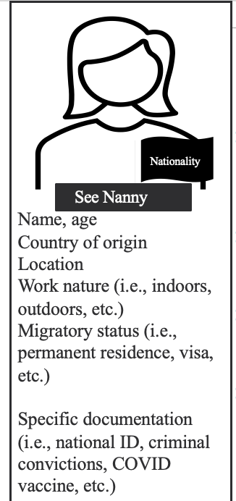
KEY FINDINGS AND REFLECTIONS
Personal characteristics, such as age, gender, nationality, and lifestyle, are marketized as part of a product (a good) where workers are easily replaceable, unveiling the commodification of DW.
There is a dominance and commodification over the worker's time, private life, and corporality, a dynamic that we call chronoproperty.
We discuss Chile's need for and lack of regulation for digital platforms. This, in addition to the need for further national policies against discrimination in the workplace.
The need to advance toward an intersectional understanding of DW’s precarious work mediated by digital platforms. This considering that domestic work is mostly performed by both national and migrant women crossed by gender, class, and race dynamics.

